Slide 1
μ
Muons, Inc.
“At Chicago Booth (School of Business), we constantly question and test ideas, and seek proof. This extraordinarily effective approach to business leads to new ideas and innovative solutions.”
“The mission of Chicago Harris (School of Public Policy Studies) is to understand and influence public policies—both through research and by preparing talented individuals to become global leaders and agents of social change.”
“The Energy Policy Institute at Chicago (EPIC) is an interdisciplinary research and training institute focused on the economic and social consequences of energy policies.”

Slide 2
μ
Muons, Inc.
Muons, Inc. in 3 Acts:
Rolland P. Johnson
Muons, Inc. (http://www.muonsinc.com/)
1 Company funded by DOE Small Business Innovation Tech Transfer Grants
developing general tools and technology for particle accelerators
with seven US universities and seven National Labs
creative staff with a broad range of skills and experience
2 Muon beam cooling for a Muon Collider
next energy frontier machine to follow the LHC
helped revive the MC, now the long-range goal of Fermilab and US HEP
Higgs boson factory
3 Designing a new kind of Accelerator-Driven Subcritical Nuclear Reactor (ADSR)
intrinsically safe, with large profits
producing synthetic diesel from natural gas and carbon for the US Navy
destroy and utilize weapons-grade plutonium
under 2000 U.S.-Russian Pu Management and Disposition Agreement

Slide 3
1 Completed Muons, Inc. Projects
μ
Muons, Inc.
Year | Completed Projects | SBIR-STTR | Research Partner |  | Phase III
2002 | Company founded | Funds
2002-5 | High Pressure RF Cavity | $600,000 | IIT (Kaplan) |  | $445,000
2003-7 | Helical Cooling Channel | $850,000 | JLab (Derbenev) |  | $3,100,000
2004-5 | MANX demo experiment | $95,000 | FNAL (Yarba) |  | $22,230
2004-7 | Phase Ionization Cooling | $745,000 | JLab (Derbenev)
2004-7 | H2Cryostat - HTS Magnets | $795,000 | FNAL (Yarba) |  | $1,400,000
2005-8 | Reverse Emittance Exch. | $850,000 | JLab (Derbenev)
2005-8 | Capture, ph. Rotation | $850,000 | FNAL (Neuffer) |  | $198,900
2006-9 | G4BL Simulation Program | $850,000 | IIT (Kaplan) |  | $8,732,479
2006-9 | MANX 6D Cooling Demo | $850,000 | FNAL (Lamm) |  | $495,630
2007-10 | Stopping Muon Beams | $750,000 | FNAL (Ankenbrandt) |  | $410,488
2007-10 | HCC Magnets | $750,000 | FNAL (Zlobin) |  | $255,000
2007-8 | Compact, Tunable RF | $100,000 | FNAL (Popovic) |  | $23,400
2008-9 | Rugged RF Windows | $100,000 | JLab (Rimmer)
2008-9 | H2-filled RF Cavities | $100,000 | FNAL (Yonehara) |  | $23,400
 | Completed Projects | $8,285,000 |  |  | $15,084,297

Slide 4
2 Completed Muons, Inc. Projects
μ
Muons, Inc.
Year | Projects In Progress | Funds | Research Partner Phase III
2008-12 | Pulsed Quad RLAs (NFE) | $850,000 | JLab (Bogacz)
2008-12 | Fiber Optics for HTS (NFE) | $800,000 | NCSU (Schwartz)
2008-13 | RF Breakdown Studies | $850,000 | LBNL (Li) ANL (Gai)
2009-12 | HOM Absorbers | $850,000 | Cornell (Hoffstaetter)
2009-13 | Quasi Isochronous HCC | $850,000 | FNAL (Neuffer) |  | $198,900
2009-10 | DC Gun Insulator | $100,000 | JLab (Poelker)
2009-13 | H-minus Sources | $850,000 | ORNL/SNS (Stockli)
2009-13 | Hi Power Coax Coupler | $850,000 | JLab (Rimmer)
2009-10 | Hi Field YBCO Magnets | $100,000 | NCSU (Schwartz)
2009-13 | Φ & f–locked Magnetrons | $850,000 | FNAL (Popovic) |  | $198,900
2010-11 | ps detectors for MCDE | $100,000 | U Chicago (Frisch)
2010-11 | Crab Cavities | $100,000 | JLab (Rimmer)
2010-11 | MC detector bkgnds | $100,000 | NIU (Hedin)
2010-13 | Epicyclic PIC | $850,000 | JLab (Derbenev)
 | Projects In Progress | $8,100,000 |  |  | $397,800

Slide 5
μ
Muons, Inc.
 | More Completed Muons | Inc. Projects
2011-12 | Adjustable Coax Coupler | $100,000 | ANL (Nassiri)
2011-12 | SAW Photoinjector | $100,000 | JLab (Poelker)
2011-12 | 2-Stage Magnetron | $100,000 | FNAL (Yakovlev) |  | $23,400
2011-12 | Efficient H-minus Source | $100,000 | FNAL (Bollinger) |  | $23,400
2011-12 | Achromatic Low Beta | $100,000 | JLab (Derbenev)
 | SBIR-STTR Projects | in Progress
2011-14 | FRIB Separator Magnet | $1,100,000 | BNL (Gupta)
2011-14 | FiberOptic Quench Detection | $1,100,000 | NCSU (Schwartz)
2011-14 | HCC Engineering Design | $1,100,000 | FNAL (Yonehara) |  | $23,400
2012-15 | S-Band RF Load | $1,100,000 | SLAC (Krasnykh)
2012-13 | Ribbon e Beam Monitor | $100,000 | ORNL/SNS (Aleksandrov)
2012-13 | RF Photoinjector Cavity | $100,000 | JLab (Rimmer) LBL(Li) |  | MuPlus
2012-15 | Complete Cooling Channel | $1,100,000 | JLab (Derbenev) |  | MuPlus
2013- | High MTBF Magnetron | $150,000 | JLab(Wang)
2014 | H-minus source | $150,000 | ORNL/SNS (Stockli)
2014 | Bi2212 30T Solenoid | $150,000 | FNAL(Shen)
 |  | $6,150,000

Slide 6
Contracts with National Labs
μ
Muons, Inc.
 |  |  |  |  | Phase III
2009-10 | Mono-E Photons |  | 2 contracts w PNNL |  | $172,588
2009-10 | Project-X and MC/NF |  | contract w FNAL |  | $260,000
2009-10 | MCP and ps timers |  | contract w ANL |  | $108,338
2010 | MAP - L2 mngr |  | 2 contracts w FNAL |  | $55,739
2010 | 805 MHz RF Cavity |  | contract w LANL |  | $230,000
2012 | MAP - L2 mngr |  | contract w FNAL |  | $40,000
2012 | PX cooling for Mu2e |  | contract w FNAL |  | $75,490
2012 | g-2 |  | contract w FNAL |  | $40,160
2012 | ACE3P 12 GeV Upgrade Studies |  | contract w JLab |  | $50,000
2013 | MAP, L2, MASS, G4beamline |  | contract w FNAL |  | $115,000
2014 | Parmela Simulations |  | contract w Niowave |  | $50,000
2014 | MAP, L2, MASS, G4beamline |  | contract w FNAL |  | $125,000
 |  |  |  |  | $1,322,315

Slide 7
Muons, Inc. Staff – CV Index
μ
Muons, Inc.
Muons, Inc. Staff
Rolland P. Johnson, Ph. D. | President/CEO
Gene Flanagan, Ph. D. | COO
James Nipper, BEE, MBA | CFO
Charles M. Ankenbrandt, Ph. D. | VP Personnel Development
Mike Neubauer, MSEE | VP Engineering
Thomas J. Roberts, Ph. D. | VP Technology Development
Robert J. Abrams, Ph. D. | Senior Experimental Physicist
Alan Dudas, MSEE | Senior RF Engineer
Vadim Dudnikov, Ph. D. | Senior Accelerator Physicist
Stephen Kahn, Ph. D. | Senior Accelerator Physicist
Grigory Kazakevich, Ph. D. | Senior Accelerator Physicist
Frank Marhauser, Ph.D. | Senior Accelerator Physicist
Leonid Vorobiev, Ph. D. | Senior Accelerator Physicist
Mary Anne Cummings, Ph. D. | Experimental Physicist
Linda Even, MSCE | Environmental Engineer
Justin Rodriguez, BA | Computational Physicist
Cary Yoshikawa, Ph. D. | Computational Physicist

Slide 8
More People
μ
Muons, Inc.
Under SBIR-STTR grants, Muons, Inc. supported or is supporting seven full-time junior Ph. D. accelerator scientists directly (Drs. Mohammad Alsharo’a, Kevin Beard, Gene Flanagan, Pierrick Hanlet, Masahiro Notani, David Newsham, Kevin Paul, and Cary Yoshikawa).
and seven indirectly through subgrants, at Fermilab, JLab, IIT, NCSU, LBNL and ODU (Drs. Katsuya Yonehara, Shahid Ahmed, Guimei Wang, Vasiliy Morozov, Frank Hunte, Dan Bowring).
Muons, Inc. supports Ph. D. students working on our projects: Ms. Mahzad BastaniNejad and Ms. Ana Samolov at ODU, Ms. Melanie Turenne at NCSU, and Mr. James Maloney at NIU. Other potential Ph. D. students are considering working on our projects as thesis topics. Melanie and Ana completed all requirements and received their Ph.D.s in 2012! Jim defended his this thesis earlier this year.
Principal Investigator collaborators for our subgrants at national labs and universities amplify our company strengths:
(e. g. Derbenev-JLab, Yarba-FNAL, Schwartz-NCSU, Hoffstaetter-Cornell, Neuffer-FNAL, Kaplan-IIT, Rimmer-JLab, Li-LBNL, Gai-ANL, Stockli-ORNL, Frisch-Uchicago,…)

Slide 9
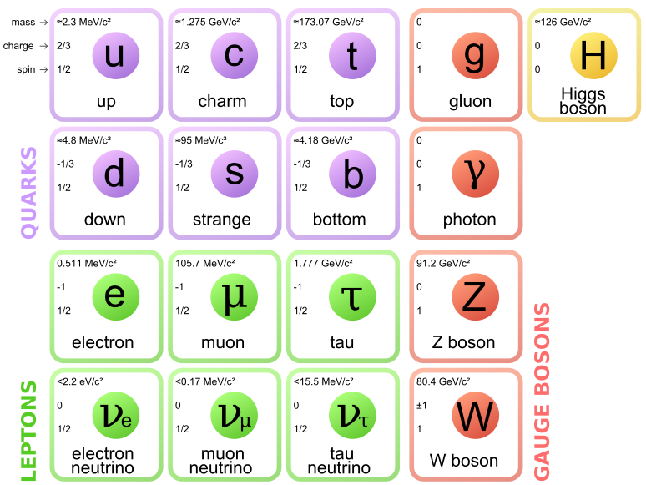
μ
Muons, Inc.
Wikipedia

Slide 10
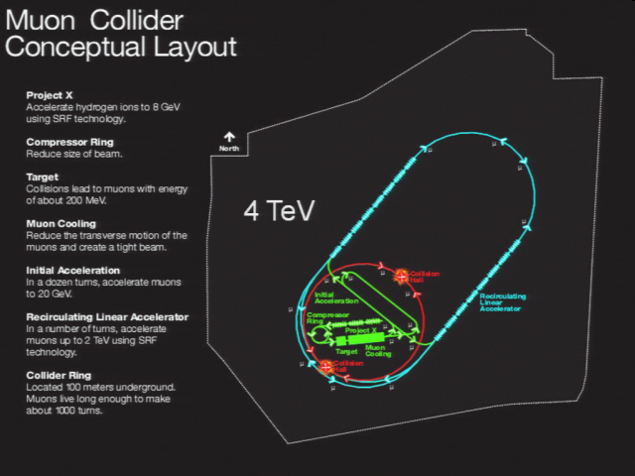
μ
Muons, Inc.

Slide 11
2 Muon Beam Cooling
μ
Muons, Inc.
Two new concepts for muon ionization cooling,
Physical designs in progress
Sufficient beam cooling for a Higgs factory and
Energy Frontier Muon Collider that fits on Fermilab site
The ideas that are basic to the prototype being designed are new for this millennium:
Hydrogen-pressurized RF cavities,
doped with oxygen,
modified to fit inside strong superconducting magnet coils,
Helical Ionization Cooling theory using Siberian snake fields in
Helical Solenoid magnets, generating 6d cooling using
emittance exchange with a continuous homogeneous absorber

Slide 12
Ultimate Goal – after the LHC: High-Energy High-Luminosity Muon Colliders
μ
Muons, Inc.
precision lepton machines at the energy frontier
achieved in physics-motivated stages that require developing inventions and technology, e.g.
MANX (a new version is in the works)
demonstrate HCC, HS, & EEX concepts (based on a prototype HCC segment)
high-intensity proton driver
simultaneous intense muon beams
stopping muon beams
useful 6D cooling w HCC, EEX
neutrino factory
HCC with RF, RLA in CW Proj-X
Z’ factory
low Luminosity collider, HE RLA
Higgs factory ← (new ideas!)
extreme 6D cooling, low beta, super-detectors
energy-frontier muon collider
more cooling, lower beta

Slide 13
μ
Muons, Inc.
Principle of Ionization Cooling
Each particle loses momentum by ionizing a low-Z absorber
Only the longitudinal momentum is restored by RF cavities
The angular divergence is reduced until limited by multiple scattering
Successive applications of this principle with clever variations leads to small emittances for many applications
Early work: Budker, Ado & Balbekov, Skrinsky & Parkhomchuk, Neuffer

Slide 14
Transverse Emittance IC
μ
Muons, Inc.
The equation describing the rate of cooling is a balance between cooling (first term) and heating (second term):
Here ε_{n} is the normalized emittance, E_{µ} is the muon energy in GeV, dE_{µ}/ds and X₀ are the energy loss and radiation length of the absorber medium, β⊥ is the transverse beta-function of the magnetic channel, and β is the particle velocity. β⊥ ~1/B, so strong magnetic field is necessary.
Bethe-Bloch
Moliere (with low Z mods)

Slide 15
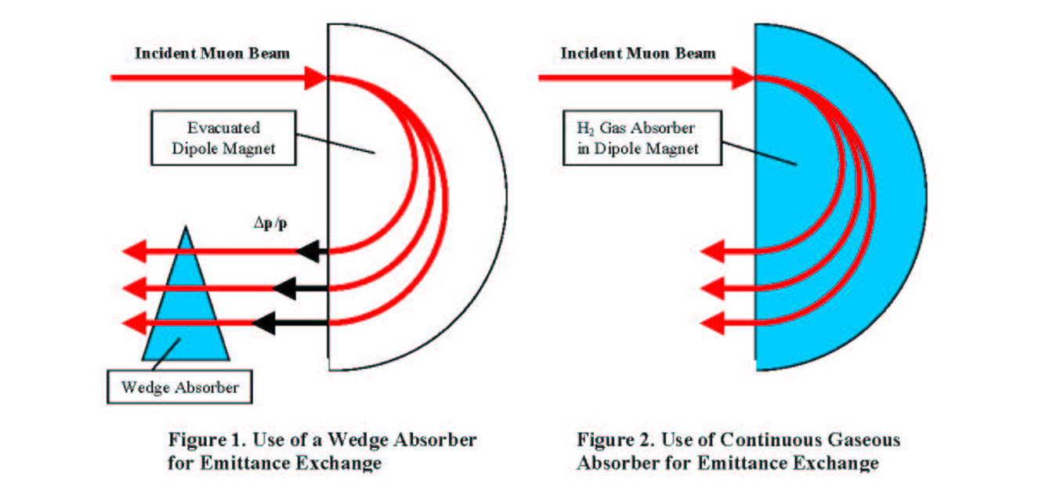
μ
Muons, Inc.
A wedge or continuous absorber combined with magnetic dispersion can be used for emittance exchange

Slide 16
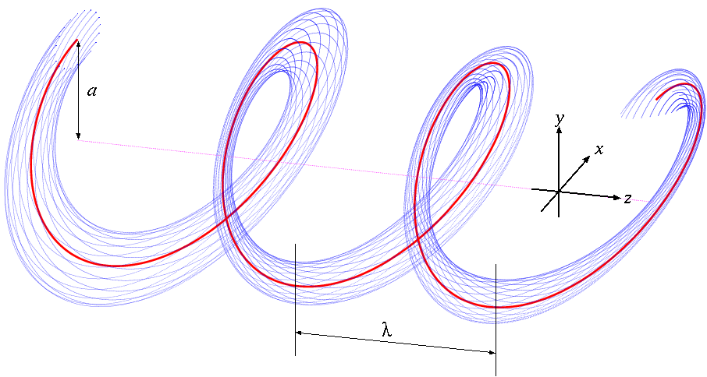
Particle Motion in a Helical Magnet
μ
Muons, Inc.
Combined function magnet (invisible in this picture)
Solenoid + Helical dipole + Helical Quadrupole
Red: Reference orbit
Blue: Beam envelope
Magnet Center
Dispersive component makes longer path length for higher momentum particles and shorter path length for lower momentum particles.
Opposing radial forces
Transforming to the frame of the rotating helical dipole leads to a time and z –independent Hamiltonian
b' added for stability and acceptance

Slide 17
Some Important Relationships
μ
Muons, Inc.
Hamiltonian Solution
Equal cooling decrements
Longitudinal cooling only
~Momentum slip factor
~

Slide 18
Hardware Development
μ
Muons, Inc.
Helical Solenoid invention to get HCC fields
4-coil NbTi HS model tested (1st 6d HCC segment)
6-coil YBCO HS model tested (last 6d HCC segment)
High Pressure H₂ Cavity development
Test cell shows no HV max dependence on external B
First beam tests show agreement with models
No RF breakdown
Ionization electrons move far enough to heat H₂ – reduce Q
Mitigated with 0.01% SF₆ dopant
Oxygen shown to be a good dopant with less corrosion

Slide 19
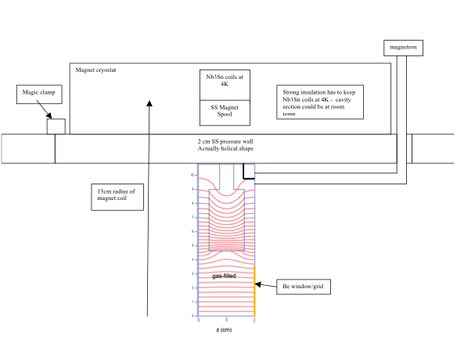
μ
Muons, Inc.
Concept of HCC Segment
Pressure wall with internal cooling
200 Atm GH2 at 325 K
or
50 Atm at 77 K
Beam center

Slide 20
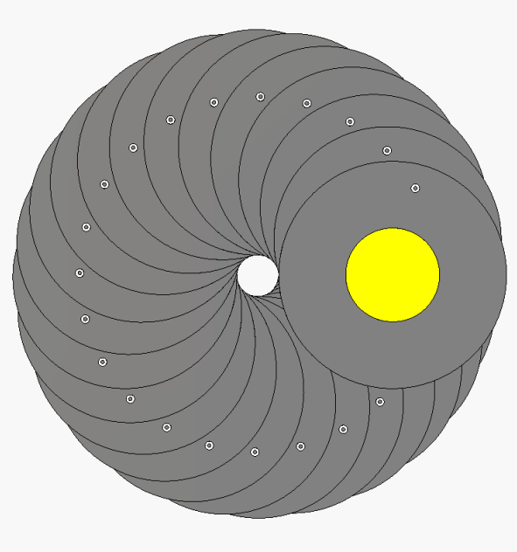
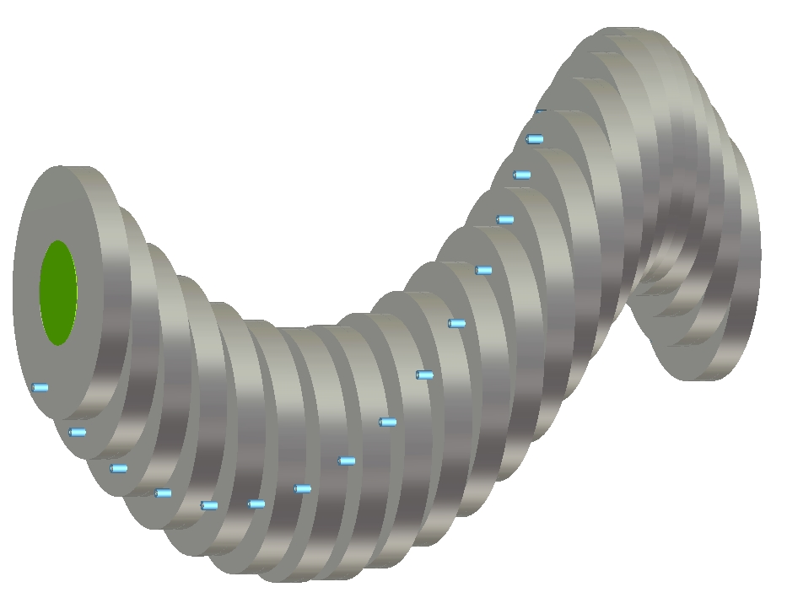
μ
Muons, Inc.
Concept of RF Cavities
End view, yellow is beam region
Side view, green is Be grid to keep RF in pillbox and allow GH2 to pass

Slide 22
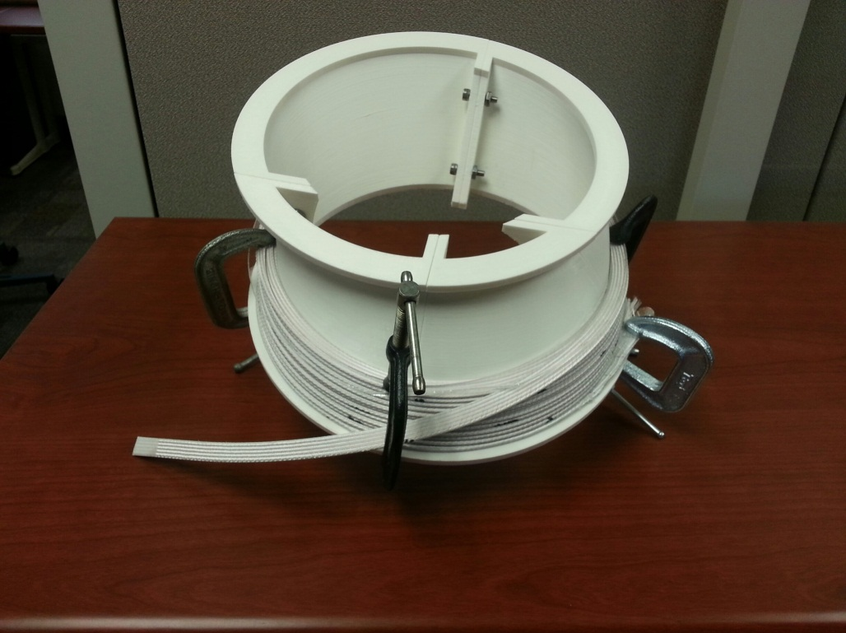
R&D for HCC magnet
μ
Muons, Inc.
• Make smooth coil structure to reduce
a discontinuity of helical field
• Use Nb₃Sn for this test
The helical solenoid provides the required B, b, and db/dr if the dimensions are correct. To put lower frequency RF cavities inside the magnet coils, the cavities are loaded with dielectric to reduce their radial dimension.

Slide 23
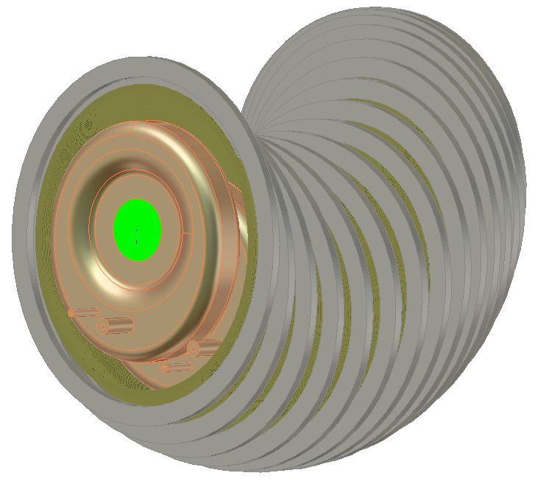
μ
Muons, Inc.
Latest designs have reentrant RF cavities
green is beam region with thin Be window
HTS coils
Space for pressure vessel and cryostat
Cu re-entrant asymmetric RF cavity
the lower frequency (650 MHz) with small radial size fits inside the pressure vessel and magnet cryostat.

Slide 24
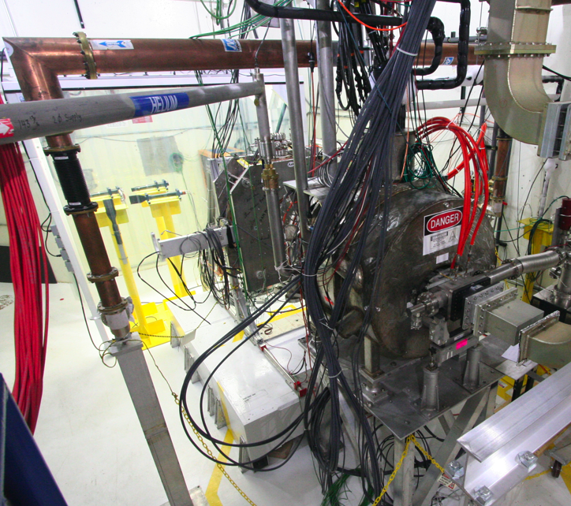
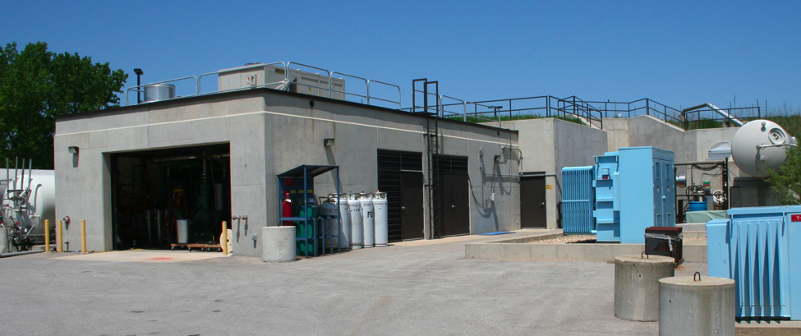
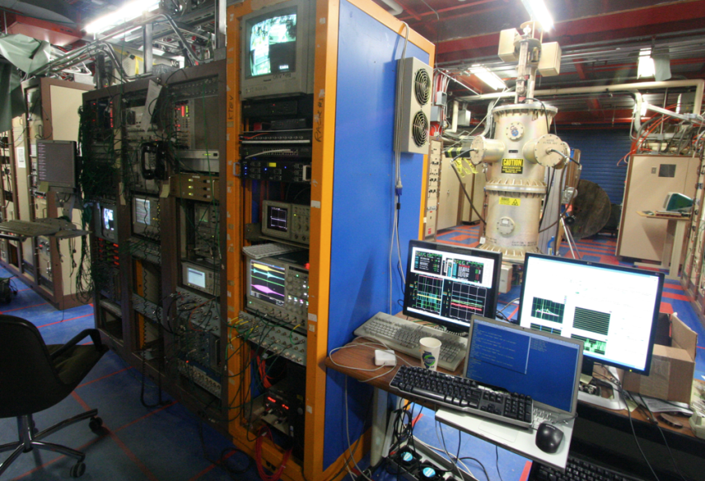
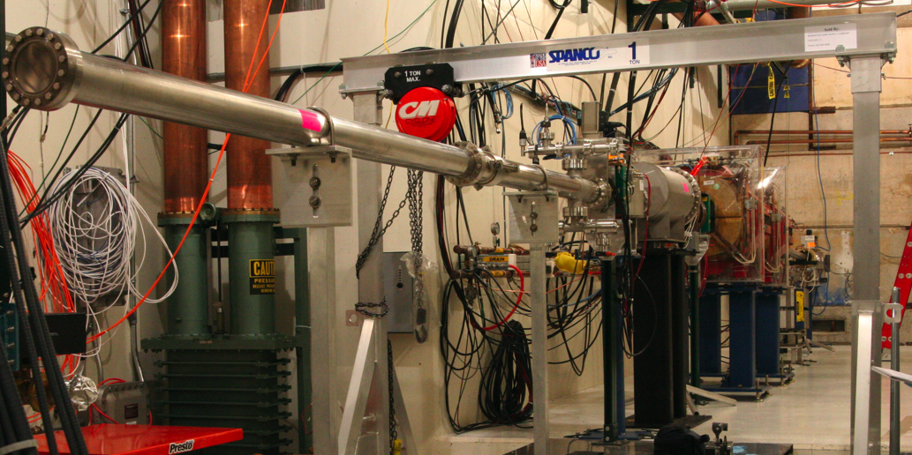
Mucool Test Area (MTA) at FNAL
Multitask work space to study RF cavity under strong magnetic fields
& by using intense H⁻ beams from Linac
MTA exp. hall
Entrance of MTA
exp. hall
200 MHz cavity
Compressor + refrigerator room
SC magnet
400 MeV H⁻ beam transport line
Workstation

Slide 25
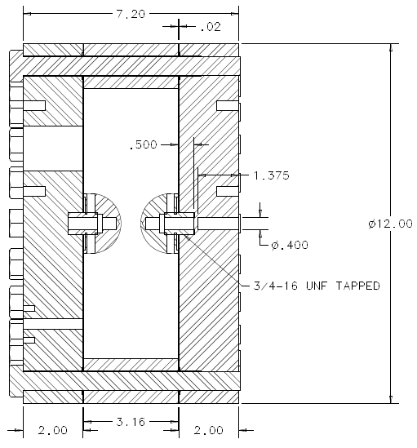
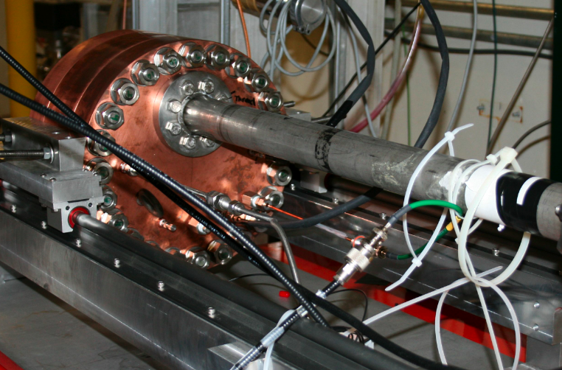
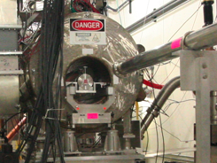
First results HPRF cavity in beam
μ
Muons, Inc.
RF cavity
RF
inlet
RF power inlet
beam
Gas inlet
Gas
inlet
RF cavity
+ collimator
in SC magnet
400 MeV H⁻
beam line
400 MeV H⁻ beam
Beam pulse length 7.5 μs
5 ns bunch gap
10⁹ H⁻/bunch
18 % of transmission in collimator system
1.8 10⁸ protons/bunch reaches to the cavity

Slide 26
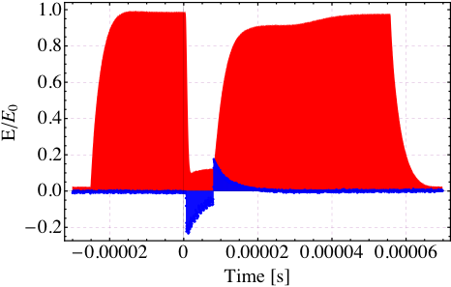
μ
Muons, Inc.
Study interaction of intense beam with dense H2 in high gradient RF field
ν= 802 MHz
Gas pressure = 950 psi
Beam intensity = 2 10⁸ /bunch
RF power is lost
when beam is on
RF power is recovered
when beam is off
RF pulse length
(80 μs)
Ionization process
p + H₂ → p + H₂⁺ + e⁻
Beam signal (x8)
(8 μs)
1,800 e⁻ are generated by
incident p @ K = 400 MeV
Huge RF power lost due to electrons’ power consumption
But, No Breakdown!!

Slide 27
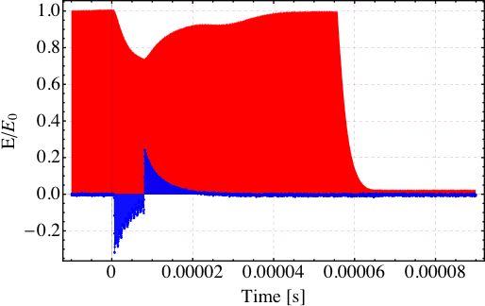
Electronegative gas
ν= 802 MHz
H2 + SF6 (0.01 % condensation)
Gas pressure = 950 psi
Beam intensity = 2 10⁸ /bunch
H2+SF6 (0.01%) gas
RF pickup voltage
Beam signal (x8)
(8 μs)
SF6 removes residual electrons
Great improvement!

Slide 28
G4beamline is our program that interfaces to GEANT4.
You can download it for free at muonsinc.com
1 mm = 4 MeV Higgs boson width

Slide 29
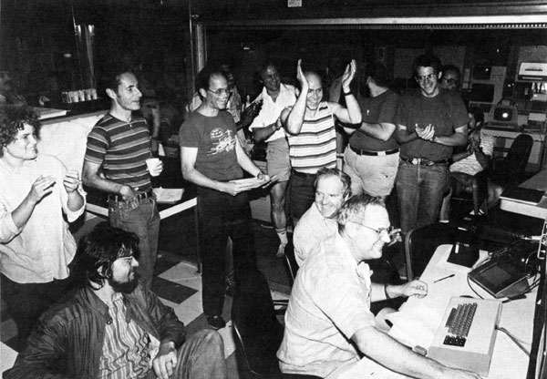
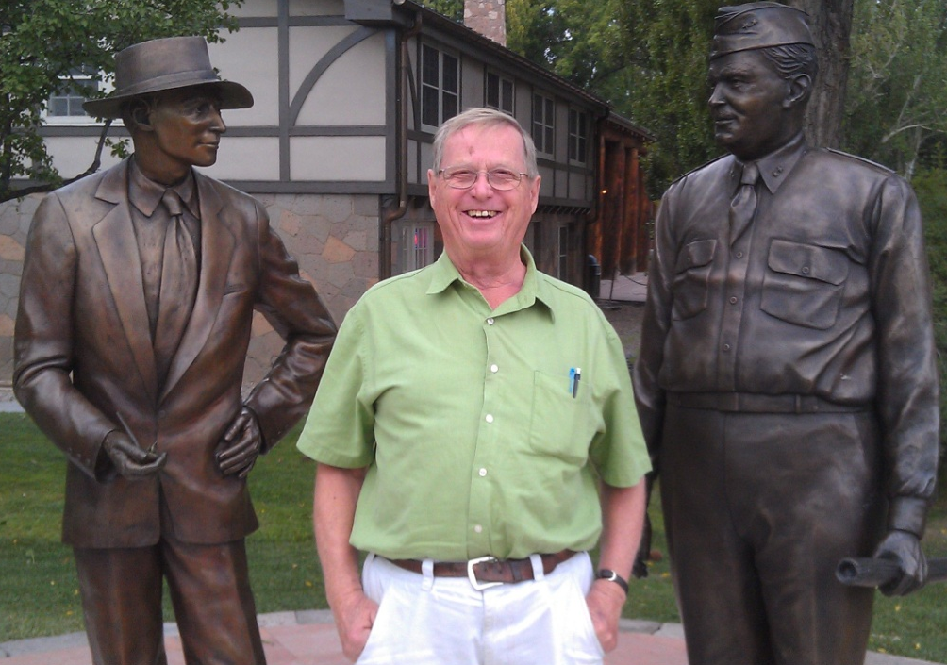
Muons, Inc.
GEM*STAR
Goal: Develop Intrinsically Safe Power
First Customers: NNSA, DOD, LLNL
μ
Rolland P. Johnson, Ph. D.
President , Muons Inc.
Charles D. Bowman, Ph. D.
President ADNA Corporation
Accelerator-Driven Neutron Applications
512 GeV at Fermilab
Charlie at LANL

Slide 30
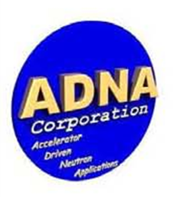
μ
Muons, Inc.
3 New Nuclear Technology to Produce Inexpensive
Diesel Fuel from Natural Gas and Renewable Carbon
Charles Bowman Rolland P. Johnson
ADNA & CLF Corps Muons, Inc.,
The long-range goal is to sell intrinsically safe and versatile nuclear reactors to address world energy needs.
The first application is an Accelerator-Driven Subcritical Reactor that burns non-enriched Uranium, Thorium, spent fuel from conventional nuclear reactors (SNF), or excess weapons-grade plutonium in a molten salt fuel to produce high-temperature heat to convert Natural Gas and renewable Carbon into liquid fuel for vehicles.
Requires development and interfacing between known technologies that
-use an SRF accelerator to produce an intense source of neutrons to
-generate process heat in GEM*STAR, a molten-salt-fueled subcritical reactor, to
-prepare methane and carbon for the Fischer-Tropsch generation of diesel fuel.

Slide 31
Present Goals
Muons, Inc.
μ
Make nuclear power desirable using
molten salt fuel – to eliminate accidental volatile releases
proton spallation – to allow subcritical operation
continuous-feed reactor - to divorce it from nuclear weapons proliferation
NNSA* first example of GEM*STAR
eliminate W-Pu –2000 U.S.-Russian Pu Management and Disposition Agreement
create clean diesel for the DOD–40 Billion gallons from 34 T W-Pu
*DOE National Nuclear Security Agency – responsible for nuclear weapons

Slide 32
μ
Muons, Inc.
GEM*STAR burns the w-Pu and renders it permanently unusable for nuclear weapons
one 10 MW, 1 GeV proton accelerator feeding four GEM*STAR units burns 34T w-Pu to provide the US DOD with 40Bg green diesel fuel, half of that needed for next 30 years
Profits from producing (renewable) diesel fuel at <$2.00/gallon will inspire funding for a Conceptual Design Report prior to a 3-year demo construction project
DOD (US Navy) interest in 40 billion gallons of green diesel from burning 34 tons of w-Pu on a DOE site could expedite the project

Slide 33
US Industry can take nuclear waste or excess plutonium and produce energy from it
μ
Muons, Inc.
Molten-salt Reactor Experiment (MSRE) 1965-1969
continuous purging of volatile radioactive elements – no zircaloy
Accelerator-Driven Subcritical Reactors (ADSR)
reactor concept uses molten salt fuel (e.g. UF₄ ,ThF_{4,} or PuF₃)
GEM*STAR
Avoids nuclear weapon proliferation concern of reprocessing for 200 years
The next step is a prototype ADSR machine to inspire industry
Inexpensive natural gas changes things in the US
New Nuclear Power cannot compete with 4.5 c/kW-h from natural gas
ADSR process heat can make synthetic diesel out of natural gas and carbon
GEM*STAR technology can
Turn excess weapons-grade plutonium into process heat,
with remnants useless for weapons,
to provide the DOD with inexpensive, green diesel fuel

Slide 34
μ
Muons, Inc.
We want to use proton accelerators to make spallation neutrons to create fissile materials and/or effectively control the fission process:
fertile β⁻ β⁻ fissile
n + ²³⁸U₉₂ → ²³⁹U₉₂ → ²³⁹Np₉₃ → ²³⁹Pu₉₄
24 m 2.4 d
n + ²³²Th₉₀ → ²³³Th₉₀ → ²³³Pa₉₁ → ²³³U₉₂
22 m 27 d

Slide 35
μ
Muons, Inc.
What is new:
SRF Proton Linacs can now provide extraordinary neutron flux and
ADSR - safer than BRs,
That operate at criticality, with many critical masses of fissile material, and fewer delayed neutrons
ADSR - more weapons proliferation resistant than BRs
which require enrichment and reprocessing
ADSR - probably less expensive than BRs
Molten salt fuel is an advantage over solid fuel pins
allows continuous purging of volatile radioactive elements
without zircaloy, that can lead to hydrogen explosions
Molten salt fuel eases accelerator requirements – no solid fuel fatigue
Subcritical ADSR operation has always been appreciated
fission stops when the accelerator is switched off

Slide 36
μ
Muons, Inc.
An intrinsic safety problem for conventional reactors is enclosed solid fuel.
a natural solution is to use molten-salt fuel
that is also well suited to accelerator-driven subcritical reactors.
A major difficulty is fatigue of UO₂ fuel in rods caused by accelerator trips – no such problem for molten salt fuel
The technology of molten-salt fuel was developed in the 1960s in the Molten-Salt Reactor Experiment (MSRE) at ORNL.
Use of molten salt fuel was later abandoned
not enough Pu-239 for bombs?
President Nixon?
(See MSRE on wikipedia for nice summary)

Slide 37
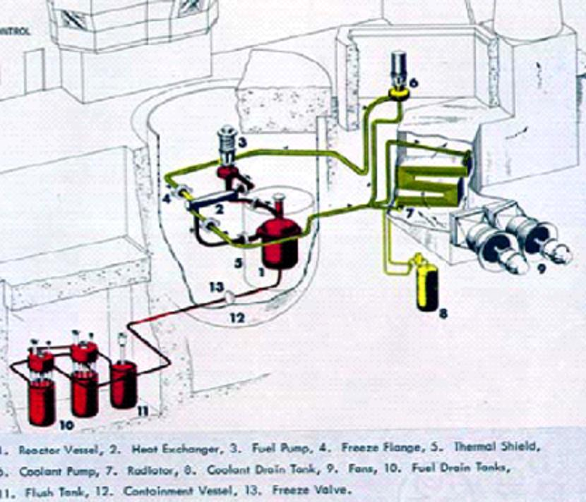
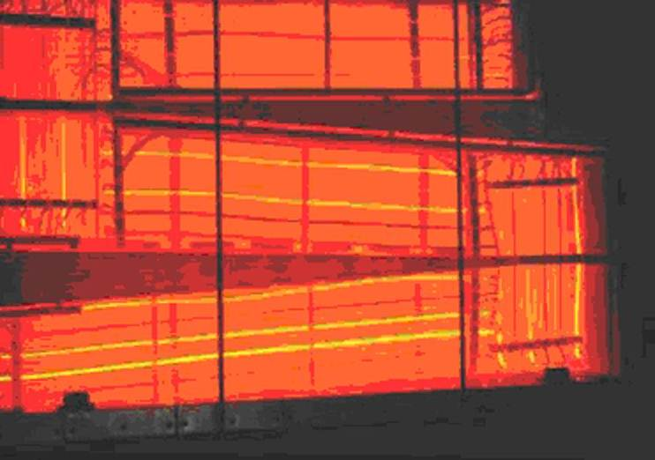
μ
Muons, Inc.
Molten-Salt Reactor Experiment
Glowing radiator

Slide 38
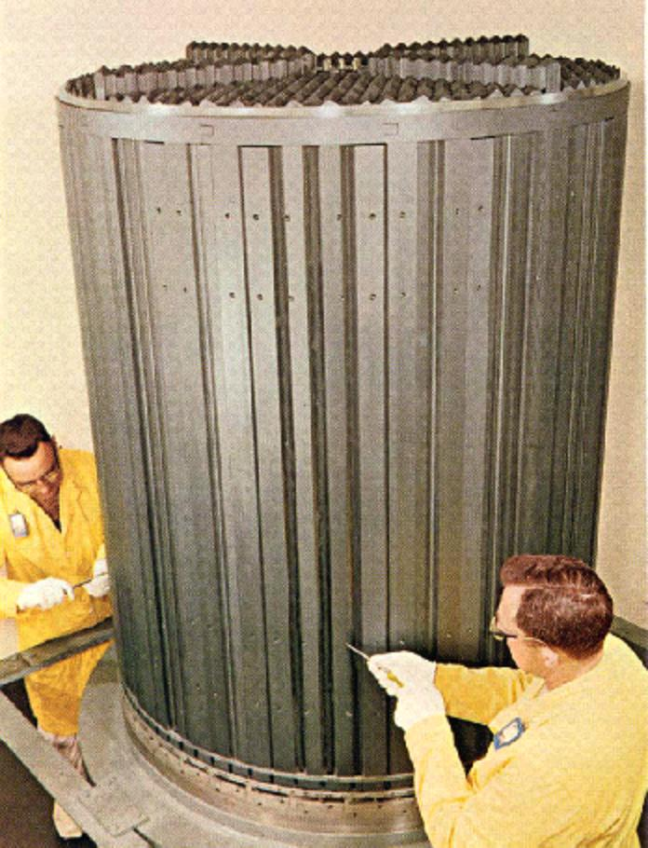
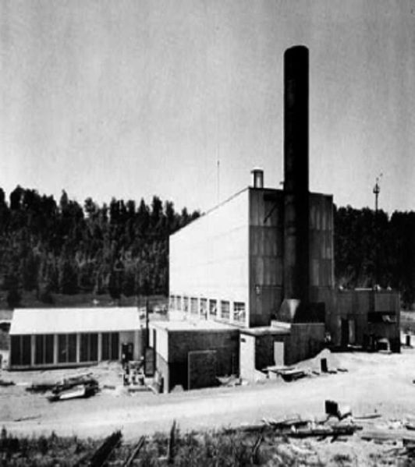
μ
Muons, Inc.
Molten-salt Reactor Experiment

Slide 40
From 1969 MSRE Report Abstract
“The MSRE is an 8-MW(th) reactor in which molten fluoride salt at 1200°F (650 C) circulates through a core of graphite bars. Its purpose was to demonstrate the practicality of the key features of molten-salt power reactors.
Operation with 235U (33% enrichment) in the fuel salt began in June 1965, and by March 1968 nuclear operation amounted to 9,000 equivalent full-power hours. The goal of demonstrating reliability had been attained - over the last 15 months of 235U operation the reactor had been critical 80% of the time. At the end of a 6-month run which climaxed this demonstration, the reactor was shutdown and the 0.9 mole% uranium in the fuel was stripped very efficiently in an on-site fluorination facility. Uranium-233 was then added to the carrier salt, making the MSRE the world's first reactor to be fueled with this fissile material. Nuclear operation was resumed in October 1968, and over 2,500 equivalent full-power hours have now been produced with 233U.
The MSRE has shown that salt handling in an operating reactor is quite practical, the salt chemistry is well behaved, there is practically no corrosion, the nuclear characteristics are very close to predictions, and the system is dynamically stable. Containment of fission products has been excellent and maintenance of radioactive components has been accomplished without unreasonable delay and with very little radiation exposure.
The successful operation of the MSRE is an achievement that should strengthen confidence in the practicality of the molten-salt reactor concept.”
NOW FAST FORWARD 40 YEARS and add an accelerator

Slide 41
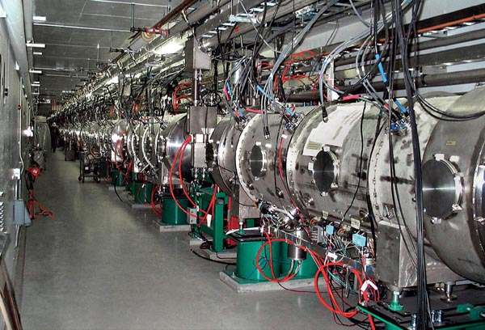
μ
Muons, Inc.
New Accelerator Technology Enables GEM*STAR
OAK RIDGE, Tenn., Sep. 28, 2009 — The Department of Energy's 1 GeV Spallation Neutron Source (SNS), breaks the one-megawatt barrier! Operating at <10% duty factor, this corresponds to >10 MW at CW.
Based on Superconducting RF Cavities, available from U.S. Industry:

Slide 42
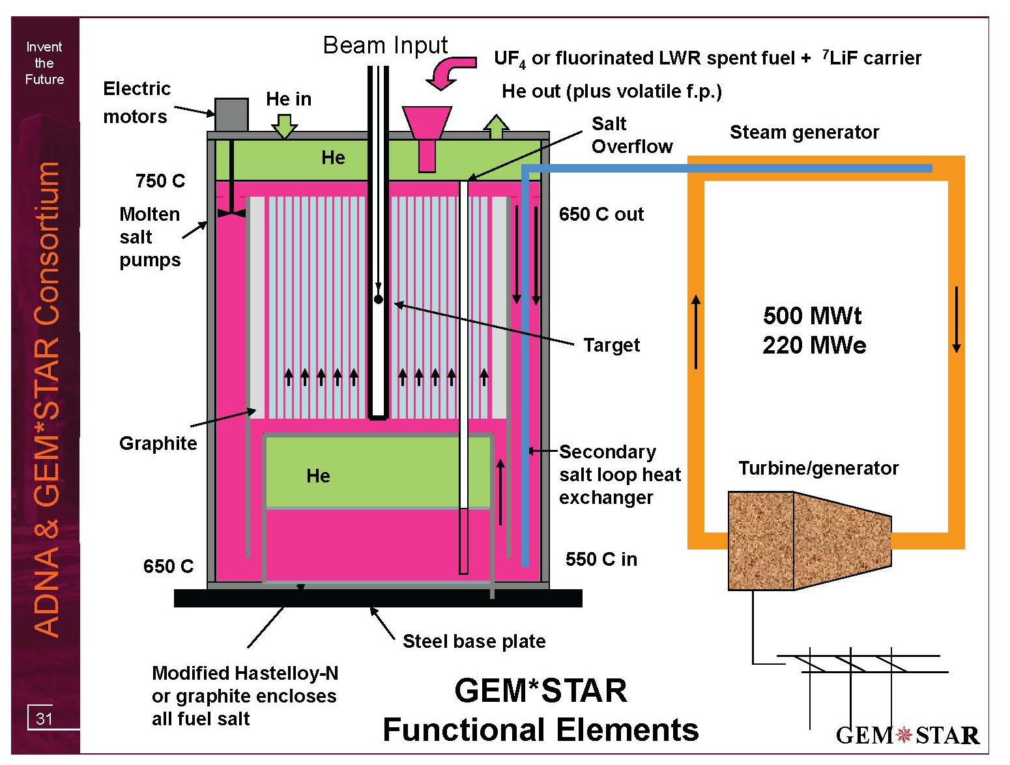
W-Pu as PuF₃ (30 g/h) plus carrier salt
2.5 MWb provides

Slide 45
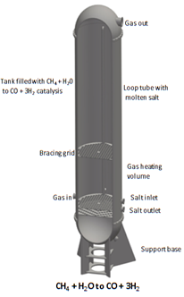

Slide 46
Is W-Pu a Killer Application?
34 metric tons of excess weapons-grade plutonium slated to be destroyed by the troubled 2000 U.S.-Russian Plutonium Management and Disposition Agreement (PMDA)[2]
GEM*STAR allows a better solution than either MOX (US) or BR (Russia)
<7% Pu240 vs >19%

Slide 47
GEM*STAR Burns W-Pu Without U or Th
34 Tons in 30 Years
Hourly fill:
30 g W-Pu
as PuF₃ +
carrier salt
Superconducting
Accelerator
2.5 mA, 1 GeV
Magnet
W-Pu
Inflow W-Pu:
93 % ²³⁹Pu
7 % ²⁴⁰Pu
Volatile f. p. removed by
closed cycle He flow
Free
surface
K_{eff}
0.98-0.99
Overflow
pipe
Target
Hourly overflow:
7.5 g as PuF₃ +
carrier salt +
22.5 g of fission product
93 % graphite
7 % salt
Non-W-Pu
W-Pu transformed
to permanent
non-weapons Pu
immediately upon
adding and mixing
Non-weapons Pu Outflow:
52.4 % ²³⁹Pu
25.4 % ²⁴⁰Pu
10.6 % ²⁴¹Pu
11.7 % ²⁴²Pu
Salt Overflow
tank
Fission power 500 MWt

Slide 48
FB BN800 MOX-LWR GEM*STAR
²³⁹Pu | α | 24,110 years
²⁴⁰Pu | α,sf | 6,561 years
²⁴¹Pu | β | 14.325 years
²⁴²Pu | α,sf | 373,300 years

Slide 50
Benefits of GEM*STAR for W-Pu
Burned W-Pu never useful for weapons
Burned W-Pu never decays to back to weapons useful material
Conversion to non-W-Pu in minutes
Pu isotopic mixture can be reduced from 34 tons to 0.2 tons if desired
Also converts C-Pu to-non-weapons-useful material
Never requires a critical mass so no control rods
No reprocessing or enrichment required
No conversion to MOX; simple conversion of Pu metal and PuO₂ to PuF₃
Fission energy converted to diesel and sold as green fuel to DOD
No stored large volatile fission product inventory as in LWRs (Fukushima)
Liquid fuel moved by He pressure; no radiation exposure to humans
No pressure vessel
Passive recovery from loss of coolant (LOCA)
Eliminating problems
avoids the need for
Defense in Depth

Slide 51
A Perfect Storm of Opportunities?
Muons, Inc.
μ
US Plan to use MOX plant and LWRs not working
SRS Plant overspent: $2B -> $5B -> asking for $2B more,
No LWR ready to accept W-Pu MOX fuel =>
Obama MOX budget on hold while alternatives examined
Eliminate W-Pu (State Department-DOE/NNSA)
Opportunity for Lavrov and Kerry to extend cooperation
2000 Plutonium Management and Disposition Agreement
(DOE Secretary Moniz was major proponent of PMDA)
Navy adds nuclear power expertise, and location for demo
Solves Navy long-range synthetic fuel need
Turn $30B liability into $40B Profit (Congress/OMB)

Slide 52
Three Seminars in One Presentation
Muons, Inc.
μ
Small Business Approach to Particle Accelerators
A small company with big dreams:
Muon Collider for Energy Frontier Science
Building prototype segment for muon beam cooling
GEM*STAR Accelerator Driven Subcritical Reactor
Intrinsically safe nuclear power, needed for CO2 reduction
First application – destroy weapons-grade plutonium
Russian-American collaboration starting

